Slide 1
Water Notes

Slide 2
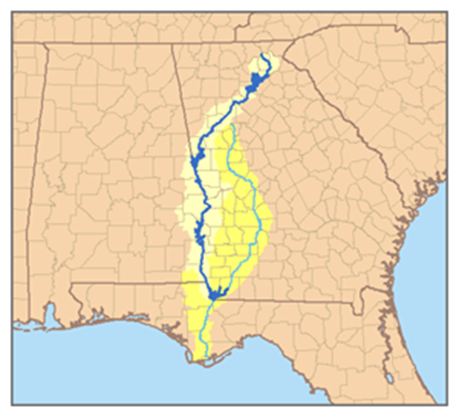
Will we fight over water in the future?
Georgia-Florida-Alabama Water War…..20 years and counting.

Slide 3
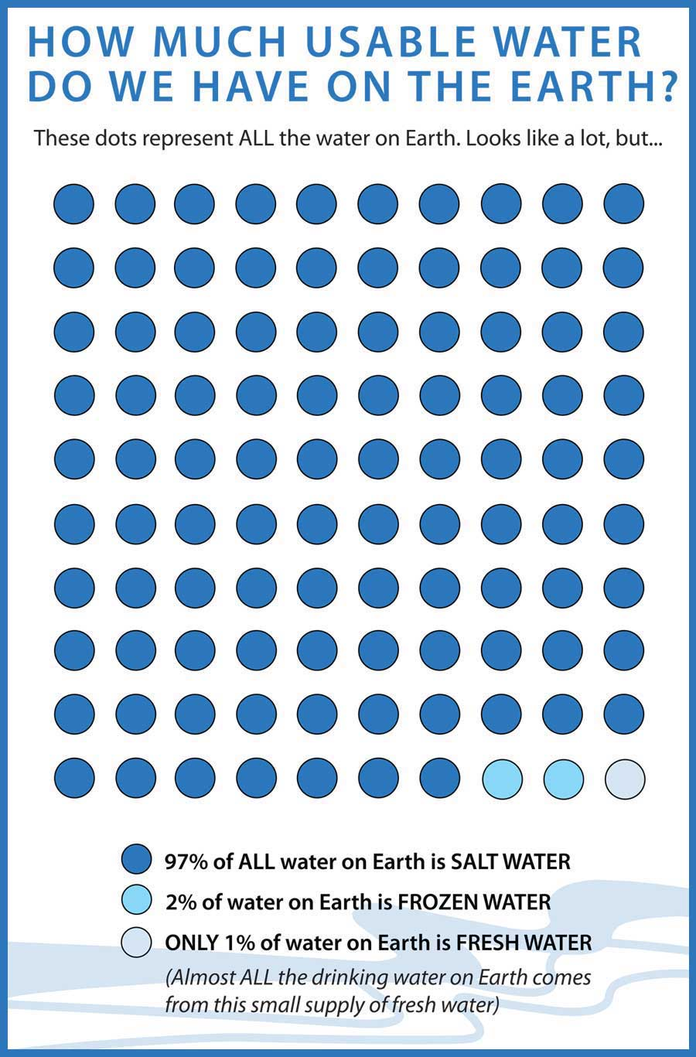

Slide 4
Surface water
The most usable form of water for humans on land.
Most people depend on surface water to live and transport commerce, grow crops, fishing and hydroelectric power.
River systems are a network of tributaries that come from a large river.

Slide 5
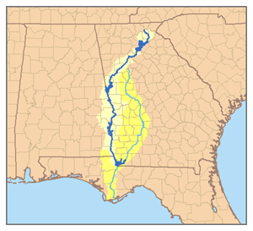
What is a Watershed?
A watershed is the water that supports a given area.
Any pollution that enters a watershed affects the entire area.

Slide 6
Groundwater
Most fresh water exists as groundwater, beneath the layers of soil and rock
The area underground that is saturated with water is the water table.
The water that exists under the water table is call an aquifer. We use aquifers to create wells.

Slide 7
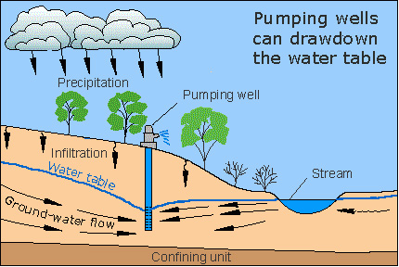

Slide 8
The End

Slide 9
Water Use and Management

Slide 10
How much water do we use?
Americans use an extreme amount of water. For recreational and residential purposes

Slide 11
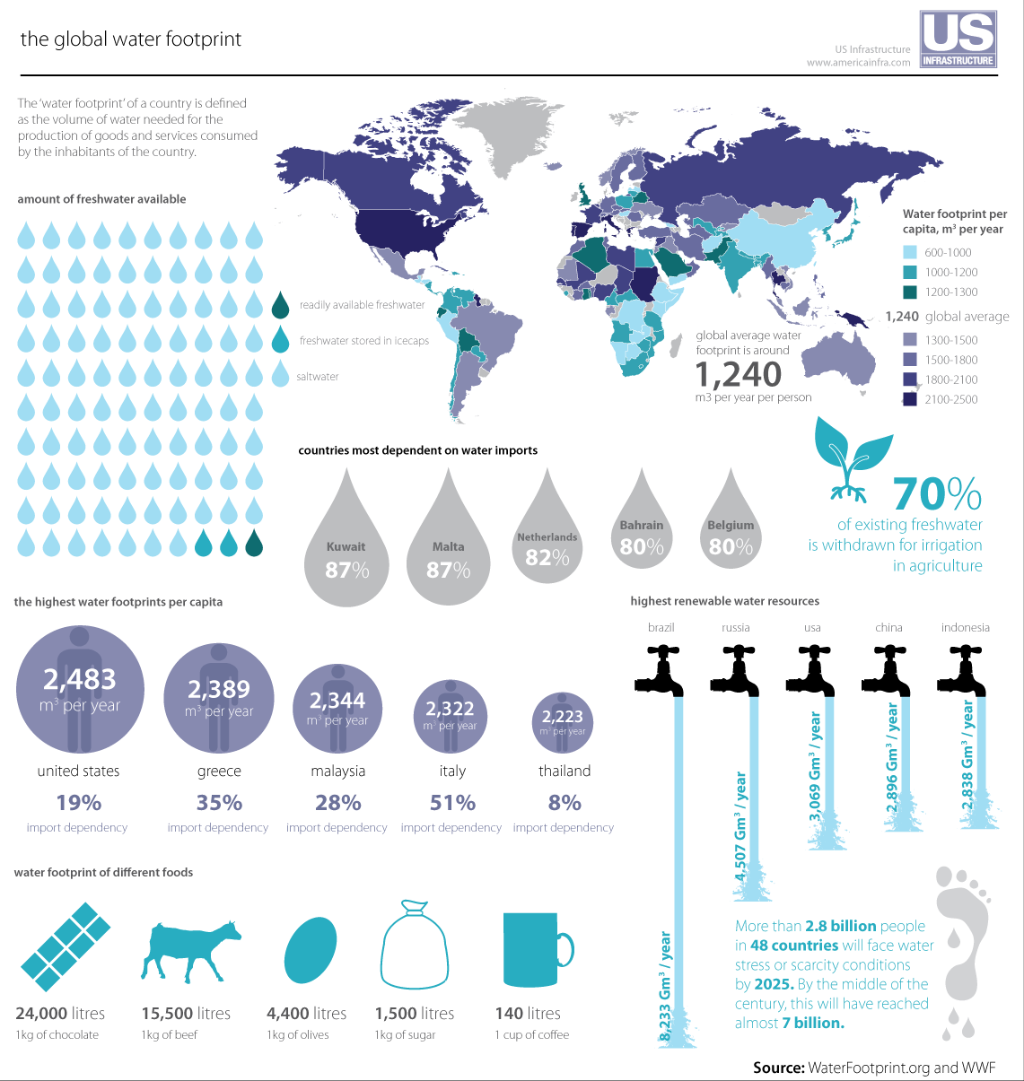

Slide 12
Water Treatment
Pathogens Removed from water | Abiotic Hazards removed from water
Bacteria | Mercury
Protozoa | Arsenic
Viruses | lead
Parasitic worms
Humans in developed countries have ways to re-use water that is available.
Water must be treated so that is potable (safe to drink).

