Slide 1
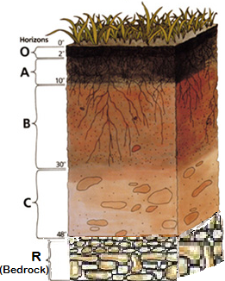
Soil Quality
What was the 1930’s “Dust Bowl”?
How did the Great Depression contribute to the problems of the Dust Bowl?
Soil pollution-
Acid deposition-
Hazardous waste-
Superfund-
Leachate-
Erosion-
Drought-
Desertification-
Terracing-
Tillage-
No-Till Agriculture-
Land reclamation-
What are some examples of soil pollution?
Where is the Love Canal?
What kind of pollution was dumped in the soil there and how did it affect the area?
Soil Horizons (label)
What is erosion?
How does erosion affect plant living in the soil?
What is a landfill?
What is a leachate?
How are they connected?
Is it possible to grow food sustainably?

Slide 2
Soil pollution- part of land degradation is caused by the presence of xenobiotic (human-made) chemicals or other alteration in the natural soil environment.
Acid deposition- phenomenon that occurs when emissions of sulfur and nitrogen compounds and other substances are transformed by chemical processes in the atmosphere and then deposited on earth in either wet or dry form.
Hazardous waste- leftover chemicals, any waste that is a risk to the health of humans or other living things
Superfund- An Act that allows the EPA to sue companies for improper disposal of waste and fund to clean up abandoned hazardous waste sites.
Leachate- a liquid that has passed through solid waste and has extracted dissolved materials (pesticides in soil)
Erosion- a process where earths surface is loosened, dissolved and worn away and transported to another place by a natural agent.
Drought- a prolonged period of abnormally low rainfall; a shortage of water resulting from th
Desertification- the process in which land in an arid or an semiarid area becomes desert like
Terracing- soil conservation method that keeps soil in multiple, small level fields
Tillage-agricultural preparation of soil
No-Till Agriculture- agricultural process that involves not turning over the soil.
Land reclamation-
Soil Quality
What are some examples of soil pollution?, land fill, chemical dumping
What is a landfill? a place to dispose of refuse and other waste material by burying it and covering it over with soil, especially as a method of filling in or extending usable land
What is a leachate?
How are they connected?
Where is the Love Canal?
What kind of pollution was dumped in the soil there and how did it affect the area?
What is erosion?
How does erosion affect plant living in the soil?
Is it possible to grow food sustainably?

Slide 3
Soil pollution- part of land degradation is caused by the presence of xenobiotic (human-made) chemicals or other alteration in the natural soil environment.
Acid deposition- phenomenon that occurs when emissions of sulfur and nitrogen compounds and other substances are transformed by chemical processes in the atmosphere and then deposited on earth in either wet or dry form.
Hazardous waste- leftover chemicals, any waste that is a risk to the health of humans or other living things
Superfund- An Act that allows the EPA to sue companies for improper disposal of waste and fund to clean up abandoned hazardous waste sites.
Leachate- a liquid that has passed through solid waste and has extracted dissolved materials (pesticides in soil)
Erosion- a process where earths surface is loosened, dissolved and worn away and transported to another place by a natural agent.
Drought- a prolonged period of abnormally low rainfall; a shortage of water resulting from th
Desertification- the process in which land in an arid or an semiarid area becomes desert like
Terracing- soil conservation method that keeps soil in multiple, small level fields
Tillage-agricultural preparation of soil
No-Till Agriculture- agricultural process that involves not turning over the soil.
Land reclamation-
Soil Quality
What are some examples of soil pollution?, land fill, chemical dumping
What is a landfill? a place to dispose of refuse and other waste material by burying it and covering it over with soil, especially as a method of filling in or extending usable land
What is a leachate?
How are they connected? Leachate is caused by improper “landfills”
Where is the Love Canal? Niagara Falls, NY
What kind of pollution was dumped in the soil there and how did it affect the area? Toxic Waste; sickness, death<$
What is erosion?
How does erosion affect plant living in the soil? Takes nutrients and resources away
Is it possible to grow food sustainably?
Yes, with planning and technology and awareness

Slide 4
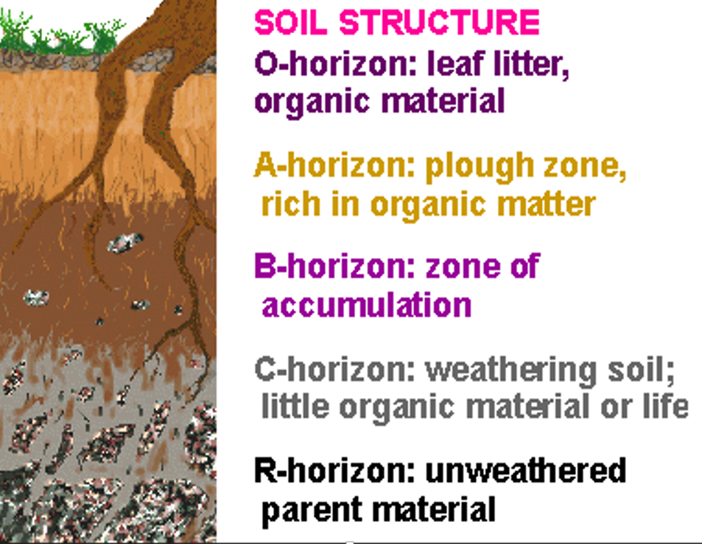
Soil Quality
What was the 1930’s “Dust Bowl”?
How did the Great Depression contribute to the problems of the Dust Bowl?
Soil Horizons (label)

Slide 5
This goes with a video from the media center I will look for it virtually

