Slide 1
Warm Up: Choose ANY one option from each column to create your RAFT.

Slide 2
3 Questions ????
What am I learning today?
What am I doing today?
How will I show you that I’ve learned it?

Slide 3
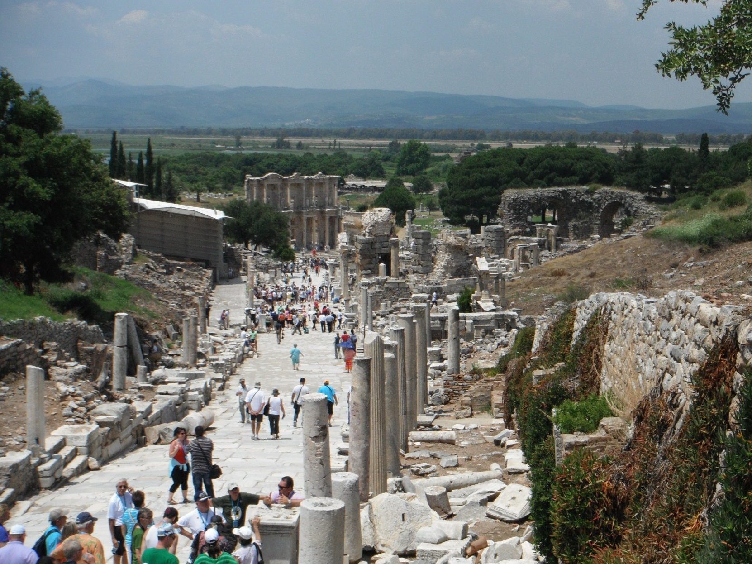
Scientific Methods

Slide 4
The Experimental Method
Science usually begins with an observation.
An observation is a piece of information we gather using our senses – sight, hearing, smell, touch, and taste (but not in the lab!).
A hypothesis is a testable idea or explanation that leads to a scientific investigation.
A prediction a logical statement about what will happen if the hypothesis is correct.

Slide 5
An experiment is a procedure designed to test a hypothesis under controlled conditions.
The variable is the factor of interest. To test for one variable, scientists usually study two groups or situations at the same time.
The experimental group is the group that receives the experimental treatment – they get something new or different.
The control group is the group that does not change anything.

Slide 6
Data – information that a scientist gathers during an experiment. This is often in numeric form but not always!
Scientists analyze the data and draw conclusions.
Experiments must be repeated to prove that the original experiment was done correctly and the same results can be gained.
Scientists then communicate the results. This is usually done by publishing them in a scientific journal.

Slide 7
The Correlation Method
When using experiments to answer questions is impossible or unethical, scientists test predictions by examining correlations.
A correlation is an association between two or more events.

Slide 8
Scientific Habits of Mind
Curiosity
The Habit of Skepticism
Openness to New Ideas
Intellectual Honesty
Imagination and Creativity

Slide 9
Statistics and Models
Reminder: In statistics the average of something is known as the mean.
The chance that something will happen is called probability.
A sample is a group of individuals or events selected to represent the population.
Models are representations of objects or systems.

